Slide 1
Technology Management
Workflow and Prioritization Collaboration

Slide 2
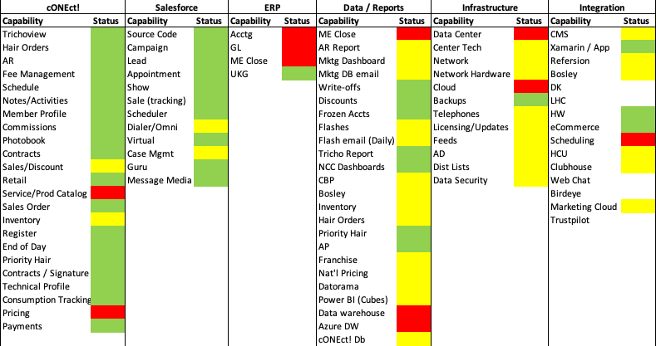
Capability Heat Map
3
2
1
# of Tickets
1
1
1
1
1
1
1
1
2

Slide 3
Technology Work Management Process
Ticket
Daily Operations
Backlog no estimate*: new or needs more information
Level 1: Basic resolution: access, password reset, printers, etc.
Backlog with estimates*
Help Desk Manager Hands off to Developers
Level 2: In-depth support requiring no development work
Assigned to a development sprint; deployment every Tues./ Thurs.
Level 3: New features, enhancements or other modifications requiring development work.
*Estimate: Confirm the development needed, estimate time to delivery

Slide 4
Level 1 & 2 Process

Slide 5



Level 1 Management
Onboarding
Username/Password Reset
Computers
Asset inventory
Printer configuration
Navigation help
Phones
Routers/WiFI
Access
Printers
Hardware
Ticket intake
Categorize
Initial Triage
Resolve L1 Issues
Escalate tickets to level 2 team
Level 1

Slide 6





Level 2 Tickets
Break/ Fix Issues
Basic Software Installation
Identify Training Needs
Simple solves/work-arounds
Configuration
Escalate to L3

Slide 7
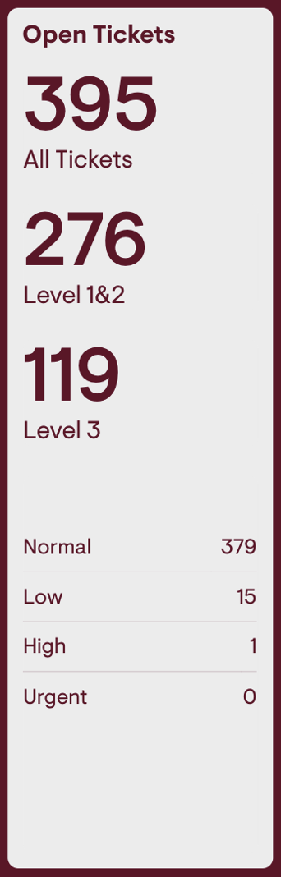
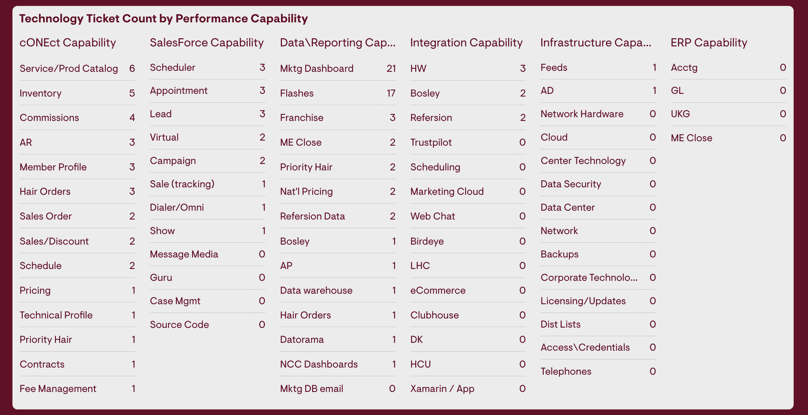
Current Ticket Count

Slide 8
Prioritization Level 1 & 2 Tickets

Slide 9
Level 3 Process

Slide 10
Level 3: Roles / Responsibilities
Functional Area | Technology
Defines / Articulates “What” | Defines / Articulates “How”
Describes & quantifies Business *Benefit | Describes & Quantifies Cost / Time
*Must be quantifiable:
Sample Measures
Lead volume
Cost per lead
Appointment
Show volume
Show rate
Cost per show
New member sales (volume
Show/sales conversion rate
Average $/Sale

Slide 11
Prioritization Filters
Revenue
Volume
Improves member experience
Improves efficiency
Compliance and Reporting

Slide 12
Prioritization Level 3 Tickets
1st Level prioritization: Within Function
2nd Level prioritization: Cross Functional
Relative ranking based on quantifiable measures
Highest value (generally) wins
Tie-breaker is Mike N.
Completion of level 2 – Org aligns to execute
1
2
High
Low
Do it now
Plan
IMPORTANCE
3
4
Training
Schedule
Low
URGENCY

Slide 13
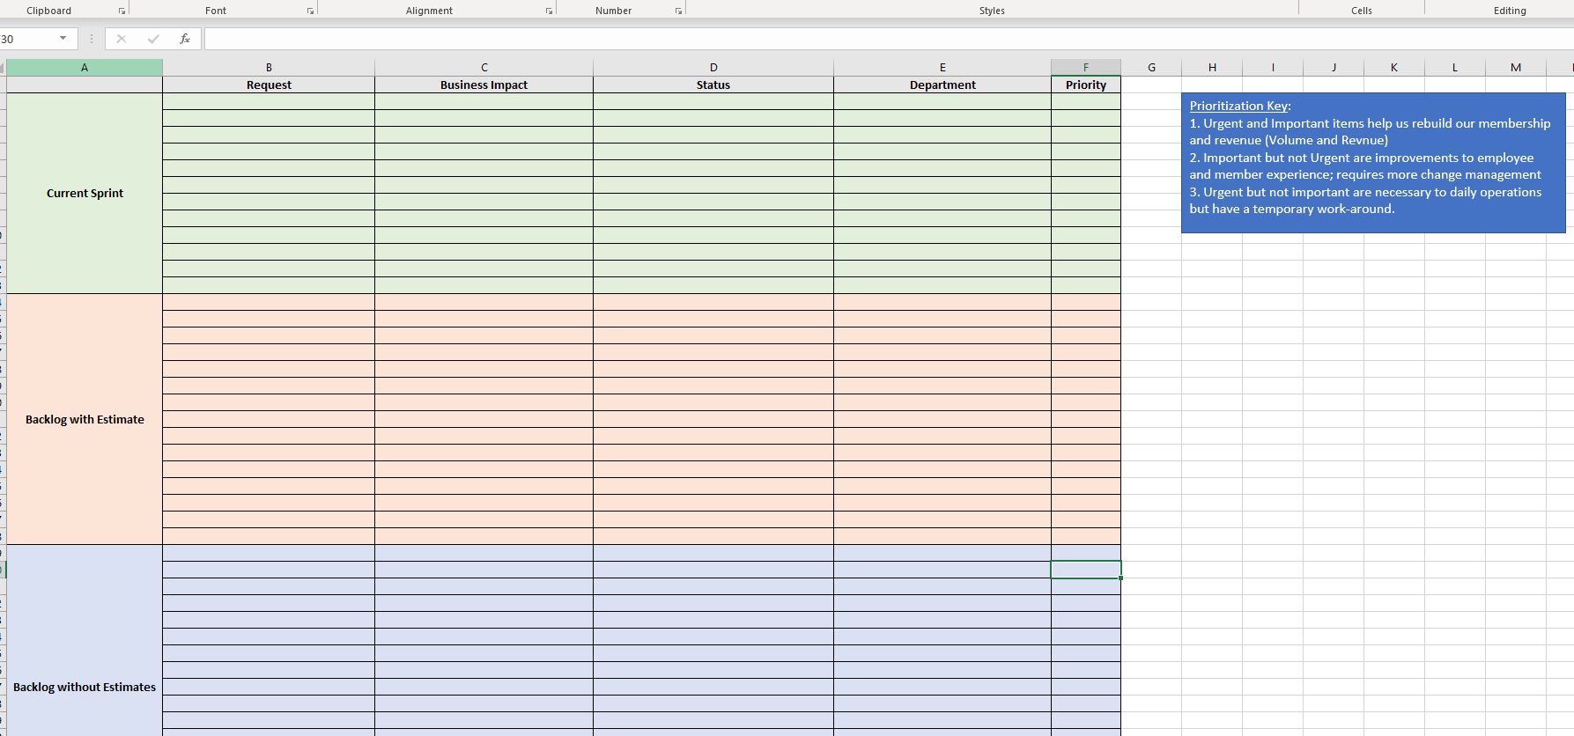
Prioritization Level 3 Tickets (Development)
Prioritization Meeting with Department Heads Every 2 Weeks
Requests that are in development sprint and have a release date.
Requests that have development effort estimated but not in a development sprint.
Prioritization Key:
1. Urgent and Important items help us rebuild our membership and revenue (Volume and Revenue)
2. Important but not Urgent are improvements to employee and member experience; requires more change management
3. Urgent but not important are necessary to daily operations but have a temporary work-around.
Requests that have not been estimated because they are new or need more information.

Slide 14
Current DevOps Count
58 in triage to be escalated to L3

Slide 15
Capacity / Resource Chart
cONEct!
Salesforce
ERP
Data / Reports
Infrastructure
Integration
Level 1 & 2
Andres Valencia 12\31
Luis Guerra (12/31)
Guiseff Rivera (12/31)
Everton Chambers
Frank Elwin
Christopher Vanderpool
James Price
Sergio Perez 12\31
Ted Wilcox
Kashif Irshad
Tabinda Javed
Emmanual McManus
Evens Basile
Sergio Perez 12\31
Roger Rush
Milton Monterroso (HD Lead) & Coming Soon: Presidio
1
Level 3
Andres Puerta – FT (12/20)
Jeferson Lopez – FT (12/31
Andrea Orozco – FT (12/31)
Trevor Bing – FT
Anthony Marable
Kevin Sirface
Chrissy Reinhold
1 - Simplus
Ladd Partners:
Jai-Lee Fontenot
Ryan Hall
Connie Manning
ShopDev
Terrence Sterling
Roger Rush
Andres Puerta (12/20)

Slide 16
Large Projects

Slide 17
ERP – Financial Force
Project Goals | Select a new tech solution to support our subscription management process.
Project Deliverables | Discovery & Design of ERP solution. Application Configuration & Build. UAT, Deployment, Data Migration & Support of New ERP solution
Budget
Schedule
Scope
Example
Accomplishments
Review of cONEct Architecture v1.3.ppt feedback “complete” High Level timeline created Blockers identified
Next Week's Goals
Gain access to cONEct to map out data movement Sandbox basic configuration work meeting earlier in the week to discuss configuration workbook and field mapping
Blockers
Finalizing Design / Sign-off Access to cONEct to for Jai-Lee to fully understand the data model “what and where data is pushing /pulling “ Configuration WB
Milestone | Due Date
Discovery & Solution Design Sign off | 12/5
Configuration Sandbox | 12/5
Configuration Workbook | 1/23
Development | 1/16
Walkthrough | 1/16
Training UAT Prep | 3/6
Training & UAT | 3/20
Deployment | 4/17
Go Live | 5/1

